Slide 1


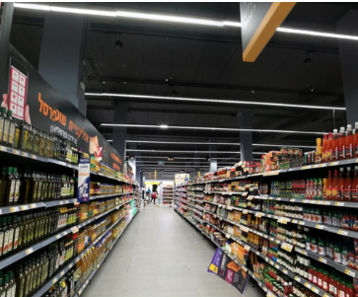
22/04/2025
From Signals to Insights: Exploring Supermarket Load Patterns
Contributor:
Baraa Zoabi

Slide 2

Data & Sources
Population data (LAMAS - Israeli Central Bureau of Statistics)
Supermarket polygon data (locations & areas)
Supermarket points Data (locations)
Precise Supermarket Points Data (Adid Scheme)
Supermarket activity logs (BigQuery tables)-8 tables

Slide 3
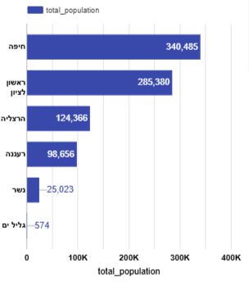
Geographic and Demographic Overview
Population
Haifa and Rishon LeZion have the largest population sizes among the selected cities
Herzliya and Ra'anana represent medium-sized cities
Nesher, with over 25K residents, is a small city but significantly larger than Galil Yam
Galil Yam stands out with an extremely low population of only 574 people

Slide 4
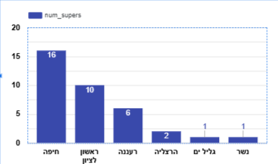
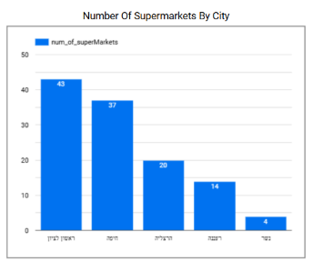
Geographic and Demographic Overview
🤔
Distribution of Supermarkets by City

Slide 5

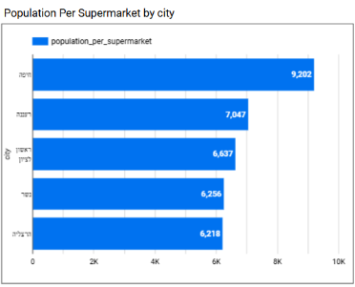
Population Load per Supermarket by City
⬤This chart shows the average number of residents served by one supermarket in each city
⬤Haifa has the highest population-to-supermarket ratio (9,202), suggesting potential service overload
⬤ Nesher and Herzliya demonstrate relatively lower ratios, indicating better supermarket coverage

Slide 6
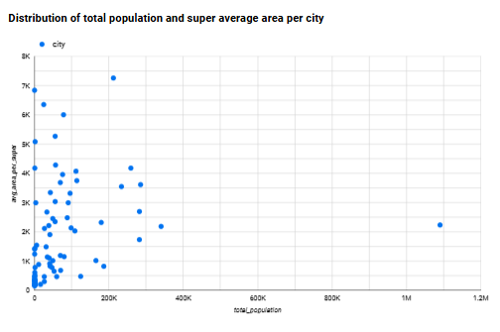
City Population vs. Average Supermarket Area
Most cities cluster in the lower population and lower area range, showing compact commercial planning.
No clear linear trend is observed-larger cities do not necessarily have larger supermarkets.
Outliers may indicate cities with fewer but larger stores, or cities with unique urban structures.

Slide 7
Employee Device Patterns in the Store
High total signals indicate consistent presence throughout the period.
Low average inaccuracy ensures the device was truly within store premises.
Appeared on 10+ different days, reflecting a regular and repeated pattern.
10+ average signals per day, showing operational rather than casual usage.
Activity hours between 6:00-22:00, aligning with store working hours.
Daily presence of above 4 hours suggests full work shifts (vs. short customer visits).
Detected in only one store and one city, confirming it's not a supplier/visitor.

Slide 8
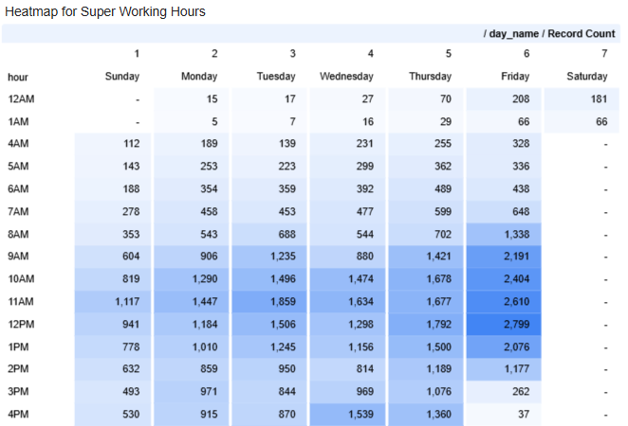
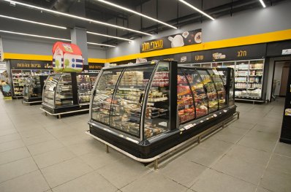
Weekly Activity Patterns Across Hours – Supermarket Foot Traffic Trends
Shufersal-Nesher

Slide 9
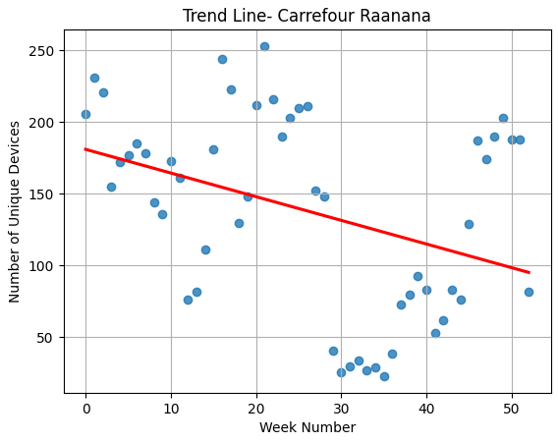
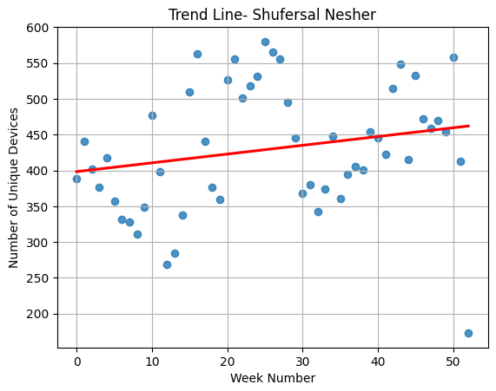
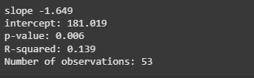
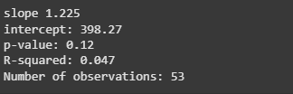
Regression - Amount of Unique Devices (Visitors) OverTime

Slide 10
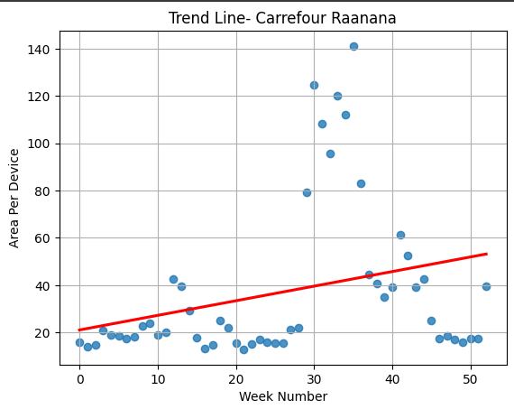
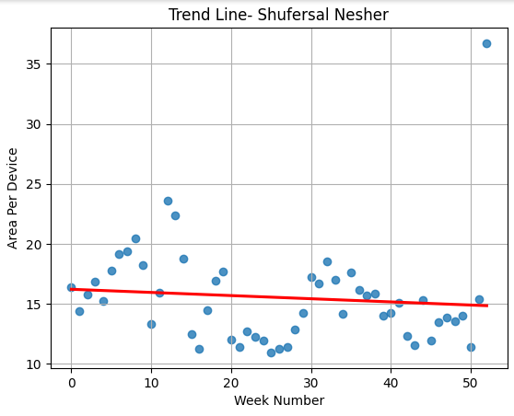
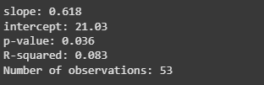

Regression 2- Amount of Unique Devices(visitors) per Area Overtime

Slide 11


Business Recommendations Based on Regression Analysis
Identify trends over time to detect significant increases or decreases in visitor activity.
Use regression insights to guide resource allocation, staff planning, or marketing campaigns.
Investigate external factors that might explain visit fluctuations, such as seasonality or local events.
Consider additional variables to improve predictive power and better understand visitor behavior.
Apply findings across branches to optimize operations and enhance customer experience.

Slide 12
Thank You

